Slide 1
Rhythms
By Laura Walsh

Slide 2
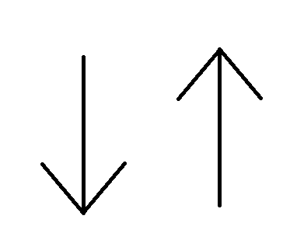
The Downs & Ups
Say:
Down
Up

Slide 3
The Downs & Ups
Say:
Down
Up
Down
Up

Slide 4
The Downs & Ups
Say:
Down
Up
Down
Up
Down
Up
Down
Up

Slide 5
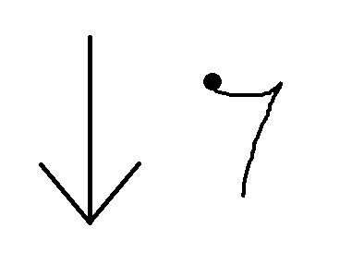
Adding Rests
Say:
Down
Down
Up
Down
Up
Down
Up
What kind of rest is this?
It’s an Eighth Rest

Slide 6
Adding Rests
Say:
Down
Down
Down
Up
Down
Up

Slide 7
Adding Rests
Say:
Down
Down
Down
Down
Up

Slide 8
Adding Rests
Say:
Down
Down
Down
Down

Slide 9
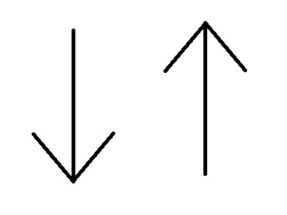
Without the Words!

Slide 10
Without the Words!

Slide 11
Without the Words!

Slide 12
Without the Words!

Slide 13
Without the Words!

Slide 14
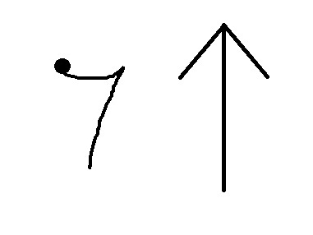
Can you rest on an “Down”?
Say:
Down
Up
Down
Up
Down
Up
Up

Slide 15
Can you rest on an “Up”?
Say:
Down
Up
Down
Up
Up
Up

Slide 16
Can you rest on an “Down”?
Say:
Down
Up
Up
Up
Up

Slide 17
Can you rest on an “Down”?
Say:
Up
Up
Up
Up

Slide 18
Can you nail it without the words?

Slide 19
Can you nail it without the words?

Slide 20
Can you nail it without the words?

Slide 21
Can you nail it without the words?

Slide 22
Can we mix all of this together?

Slide 23
Can we mix all of this together?

Slide 24
Can we mix all of this together?

Slide 25
Can we mix all of this together?

Slide 26
Can we mix all of this together?

Slide 27
Can we mix all of this together?

Slide 28
Can we mix all of this together?

Slide 29
Can we mix all of this together?

Slide 30
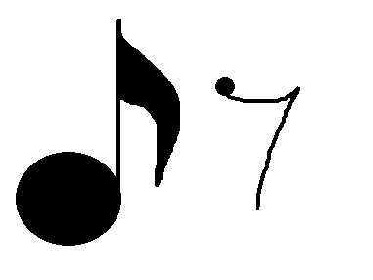
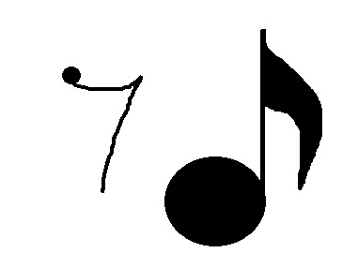
What if we translate this to music?
What kind of notes are these?
=
=
Eighth Notes!
=

Slide 31
Can you do this with notes?

Slide 32
Can you do this with notes?

Slide 33
Can you do this with notes?

Slide 34
Can you do this with notes?

Slide 35
Can you do this with notes?

Slide 36
Can you do this with notes?

Slide 37
Can you do this with notes?

Slide 38
Can you do this with notes?

Slide 39
Can you do this with notes?

Slide 40
Can you do this with notes?

Slide 41
Eastman Counting System
“tay”
=
=
1 te
=
=
1 (te)
Parentheses because it’s a rest.
=
=
(1) te

Slide 42
Say it in Eastman?
Say:
1
te
2
te
3
te
4
te

Slide 43
Say it in Eastman?
Say:
1
te
2
te
3
te
4
(te)
Don’t say it outloud!
It’s a rest and is in parentheses!

Slide 44
Say it in Eastman?
Say:
1
(te)
2
(te)
3
(te)
4
(te)

Slide 45
Say it in Eastman?
Say:
(1)
te
(2)
te
(3)
te
(4)
te

Slide 46
Say it in Eastman?
Say:
1
te
2
(te)
3
te
4
(te)

Slide 47
Say it in Eastman?
Say:
1
te
(2)
te
3
te
(4)
te

Slide 48
Without the Eastman written in?

Slide 49
Without the Eastman written in?

Slide 50
Without the Eastman written in?

Slide 51
Without the Eastman written in?

Slide 52
Without the Eastman written in?

Slide 53
Without the Eastman written in?

Slide 54
Without the Eastman written in?

Slide 55
Without the Eastman written in?

Slide 56
Without the Eastman written in?

Slide 57
Without the Eastman written in?

Slide 58
Without the Eastman written in?

